Slide 1
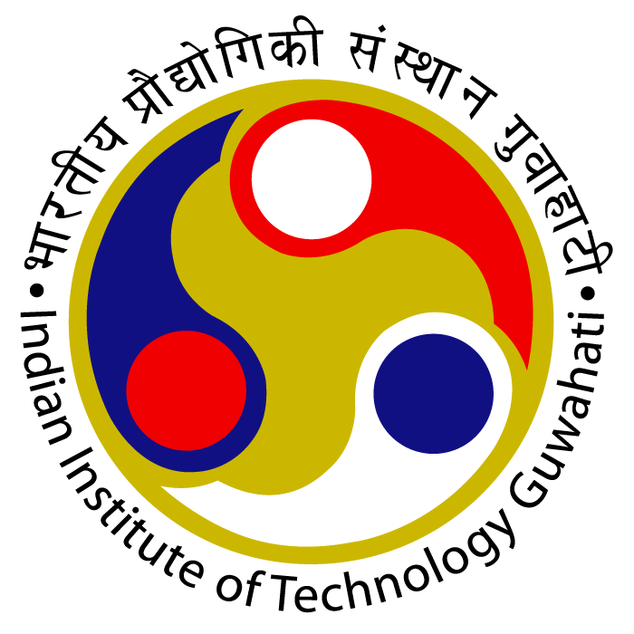
"Exploring Structured Light Waves: Concepts, Types and their Generation"
Vishal Vishwakarma IIT GUWAHATI
16-08-2024
Supervisor: Bosanta Ranjan Boruah
Notes:
Good Morning Everyone ,My name is vishal Vishwakarma.I am a MSc physics student Here In IIT G.My MSc project is under Bosanta Ranjan Boruah. I am here present the exploring structured light waves:Concepts ,types and their Generation.

Slide 2
Contents:
1. Introduction to Structured Light Waves
2. Types of Structured Light Waves
3. 2D Structured Light Waves
4. 3D Structured Light Waves
5. Spatial Structured light Waves
6. Spatiotemporal light waves
7.Generation of Structured Light Waves
8.Discrete Devices
9. Fiber-Based Methods
10. Integrated Circuits
11. Comparison of Techniques
12.Applications
13.Challenges and Future Directions
14.Conclusion
Notes:
Here is the content,I will be going through each section separately.

Slide 3
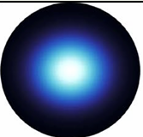
Introduction to Structured Light Waves
Definition: Light waves with intentionally controlled degree of freedom of light such as phase, amplitude, and polarization.
Example :Gaussian Beam.
Notes:
Here is structured light waves which is essentially intentionally manipulated degree of freedom of light such as phase ,amplitude,and polarisation.Example Gaussian Beam which has maximum intensity at centre,gradually decreasing towards the edges.

Slide 4
Types of Structured Light Waves
Spatial Structured light Waves.
Spatiotemporal Structured light Waves.
Notes:
Here we have two categories of structured light beam one is Spatial Structured light beam and next one is Spatiotemporal beam.Lets go for spatial structured light beam

Slide 5
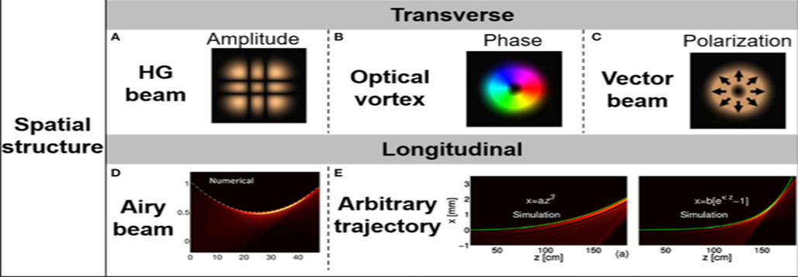
Spatial Structured Light Waves
Definition: Structured in the spatial domain (x, y, z).
Examples: Vortex beams, Hermite-Gaussian modes.
Generation: Using SLMs and DOEs.
Notes:
Spatially structured light waves means Uniqly Structured degree of freedom of light only in space.They can be generated using SlM technique.(spatial light modulator).Spatially structured light waves can be categories in trannsverse and longitudinal beams.

Slide 6
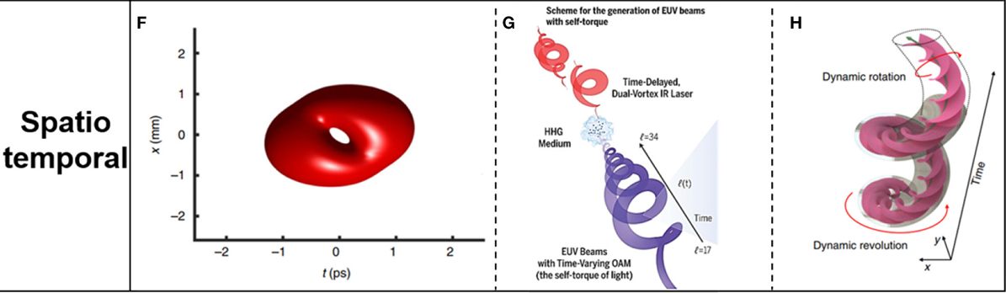
Spatiotemporal Structured Light Waves
Definition: Structured in both space and time.
Examples: Flying focus, spatiotemporal vortex pulses.
Generation: Pulse shaping techniques and ultrafast optical devices

Slide 7
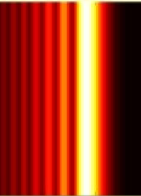
2D Structured Light Waves Examples:
Airy Beams:
Definition: Non-diffracting beams with a curved trajectory.
Generation: Generated via cubic phase modulation and special optical elements(Hollowgraphic diffraction).
Notes:
Airy beam are unique type of Structured light they have self healing property meaning maintain their shape over long distances.
Can be created using SLM and Computer generated Hollography ,
When illuminated by a laser the hologram pattern is designed based on the phase and amplitude profile of the airy function.
While in Slm ,imprint a phase pattern on a laser beam,converting it into Airy beam

Slide 8
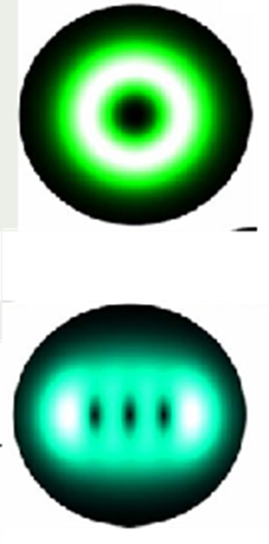
3D Structured Light Waves Examples:
Laguerre-Gaussian (LG) Modes:
Definition: Doughnut-shaped intensity with helical phase front, carrying orbital angular momentum.
High-Order Laguerre-Gaussian (GHLG) Modes:
Definition: Complex versions of LG modes with multiple concentric rings.
Notes:
LG beam are type of optical beam with specific intensity profile ,characterised by dought nut like shaped and a helical phase front.
GHLG beam is a typical optical beam combine the characteristics of HG beams and LG beams

Slide 9
generating structured light waves
Structured Light Waves can be generated by these methods:
1. Discrete Devices 2. Fiber-Based Methods 3. Integrated Circuits

Slide 10
Discrete Devices
optical components used to manipulate and structure light.
Types:
- Spatial Light Modulators (SLMs): Modulate light's phase, amplitude, or polarization.
- Diffractive Optical Elements (DOEs): Use surface structures to diffract light.
- Digital-Mirror-Device: shape the two dimensional beam, Controlling Optical path using Micro Mirror.
-Phase plate
-Cylindrical lenses pair
- Applications: Beam shaping, holography, optical trapping.
Notes:
SLM modulates the two dimensional transverse phase of a input gaussian beam .They work using an array of pixel,each capable of independently altering the light Passing through them…Optical vortex beam can be only produced phase only SLM.
DMD:Digital mirror device:is a type of MicroElectrochemical System that is widely used in precise light Modulation.DMD shape

Slide 11
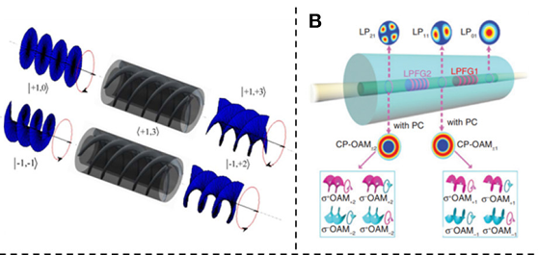
Fiber-Based Methods
Use of optical fibers to generate and transmit structured light.
- Types:
- Mode Division Multiplexing (MDM): Generating multiple light modes within a single fiber.
- Few-Mode Fibers (FMF): Propagation of structured modes like Laguerre-Gaussian beams.
- Advantages: High efficiency, long-distance transmission, compatibility with existing fiber networks.
Notes:
Fibers generate structured light by supporting multiple modes and using specialized designs like few-mode, hollow-core, and spiral fibers to create complex light patterns such as vortex beams.

Slide 12
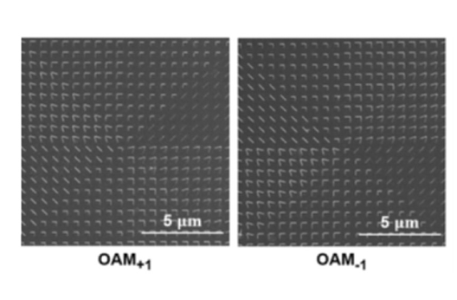
Integrated Circuits
Optical-chip devices that manipulate light at the nanoscale using photonic integrated circuits (PICs).
- Types:
- Integrated Spatial Light Modulators:SLMs integrated into circuits that modulate the phase of light to create various structured light patterns.
Metasurface-Based Circuits:Nano-structured surfaces integrated onto a chip that can control light at subwavelength scales to generate highly structured beams.
Example : Can create Hermite-Gaussian or Laguerre-Gaussian modes, directly from the chip.
Notes:
design of integrated circuits allows for the customization of optical properties, enabling the generation of a wide variety of structured light modes tailored to specific applications.

Slide 13
Comparison of Techniques
Discrete Devices vs. Fiber-Based vs. Integrated Circuits:
- Flexibility and Complexity: Discrete devices offer high flexibility, integrated circuits offer scalability.
- Transmission and Efficiency: Fiber-based methods excel in long-distance applications.
- Cost and Integration: Integrated circuits are cost-effective for mass production.

Slide 14
Applications of structured light waves
- Optical Communication: Enhancing bandwidth and data transmission rates.
- Quantum Information Processing: Generating entangled photon states on-chip.
- Medical Imaging: Improving resolution and contrast in non-invasive imaging techniques.

Slide 15
Challenges and Future Directions
- Challenges:
- Precision in fabrication.
- Integration with existing technologies.
- Loss minimization in fiber-based methods.
- Future Directions:
- Development of hybrid systems combining different methods.
- Innovations in materials and fabrication techniques.

Slide 16
Conclusion
Concepts:
We explored structured light waves, And their Geometrical Representation.
Types: We covered 2D, 3D, and 4D structured light, including Gaussian modes, Airy beams, Laguerre-Gaussian modes, and spatiotemporal pulses.
Generation: We examined methods using discrete devices, fiber-based techniques, and integrated circuits for creating structured light waves.

Slide 17
Thank you

